Slide 1
Third Eye
Uipath HyperHack -20.10 Product Release
Citizen Portal to report Traffic Offences
Vishnuvarthan Ponnuraj
RPA Developer
Work Email :Vishnuvarthan.Ponnuraj@dhl.com
Email : vishnuvarthan47@gmail.com

Slide 2
Contents
Introduction
Process Description
Solution Diagram
Third Eye – Portal screens
Third Eye – Home Page
Third Eye – Report & Check Violation Page
Data Service
Document Understanding

Slide 3
Introduction
Third Eye aims in providing an opportunity to the citizens to report any traffic offences that they come across in their daily lifetime .
Third Eye uses combination of Uipath products to automate the complete process Lifecycle right from reporting the violation.
Third Eye comprises of :
Uipath apps – To provide a seamless UI experience
Uipath Data Service – Data modeling and Storage Capabilities
Uipath Bots – These runs as a part of the Uipath Apps to fetch and insert Data
Document Understanding – To extract the vehicle Number Information from the Reported Vehicle Images
Action Centre - To Validate and to Approve/Reject the Reported Violations

Slide 4
Process Description
Third Eye allows the Users to report and check the status of the reported traffic violations .
Any user can Report the violations through the Third Eye portal built on Uipath Apps. Once the report is submitted ,The record will be updated in the Uipath Data service with status as “pending approval” and an email will be generated to the person who reported the violation .
The person should reply with the Violator’s vehicle image . Once the Violator image is received , The bot extracts the image and then Saves to the Folder based on the BaseFolder/Date/Challan extracts the vehicle number information using Document Understanding capabilities .
This will be validated Manually in Action Centre . This can be approved/Rejected .
If approved , an Email will be sent to the owner of the vehicle ( Assumption : Vehicle Database is available with all the respective information)
If Rejected , an Email will be generated to the Submitter if Rejected .
Users are also Provided with the Page to check the Violation Status where the input is the reference ID/Challan ID.

Slide 5
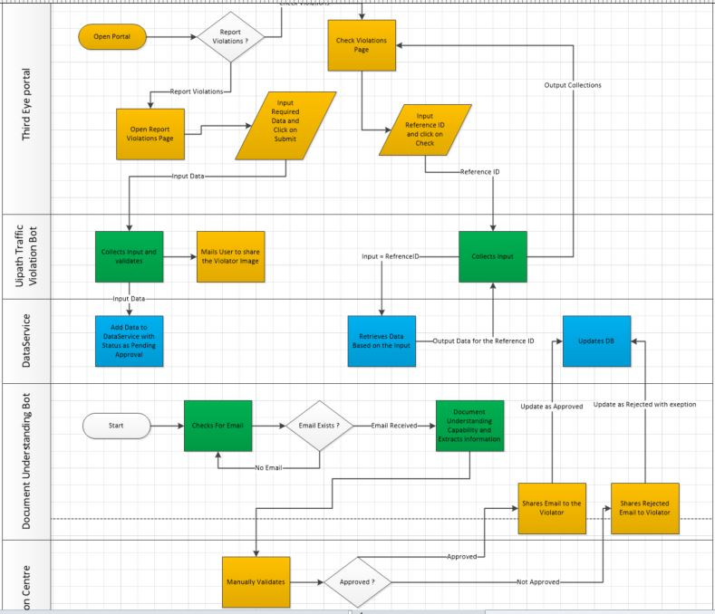
Solution Diagram
Solution Diagram
 | - Requires Manual Interaction
 | - Handled By Bot
 | - Data Service Interaction

Slide 6
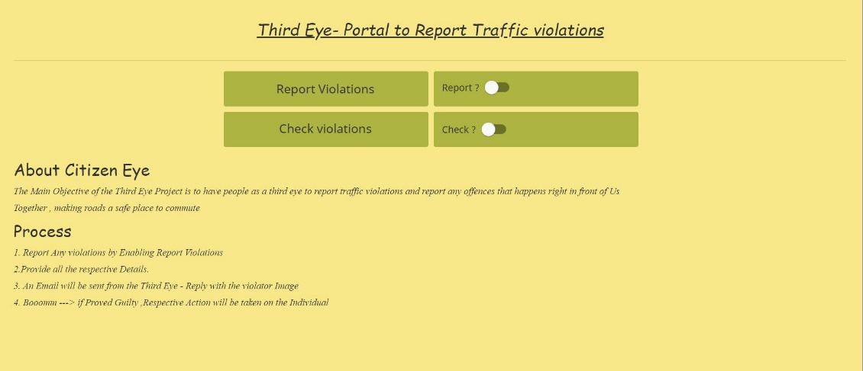
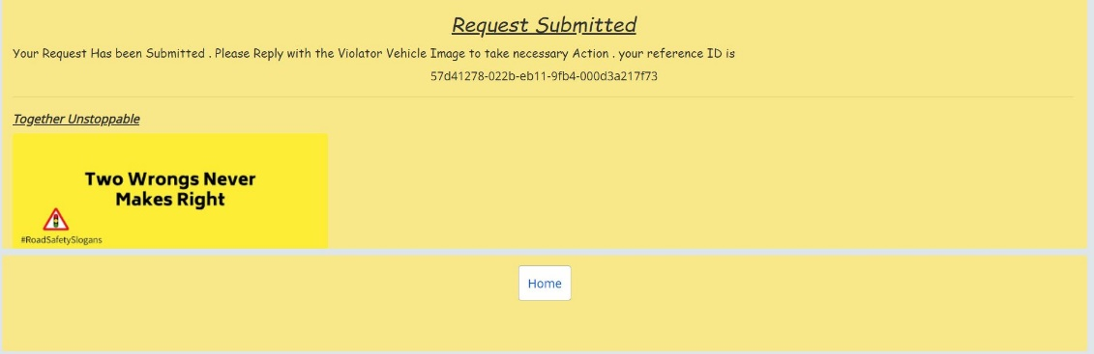
Third Eye – Home Page
Portal URL | https://cloud.uipath.com/vishnu123/apps_/default/run/production/ID0154cdb219374f77954ee98ed72bf95e

Slide 7
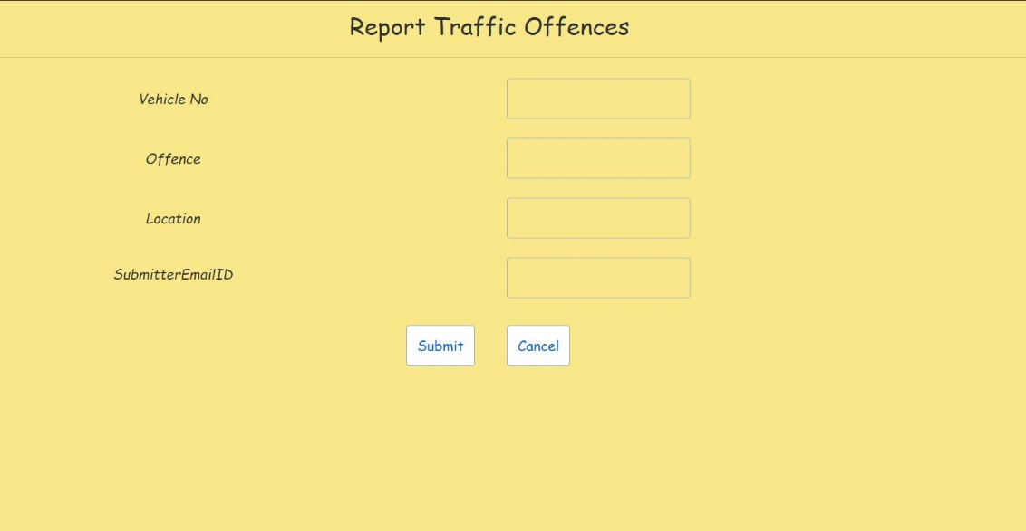
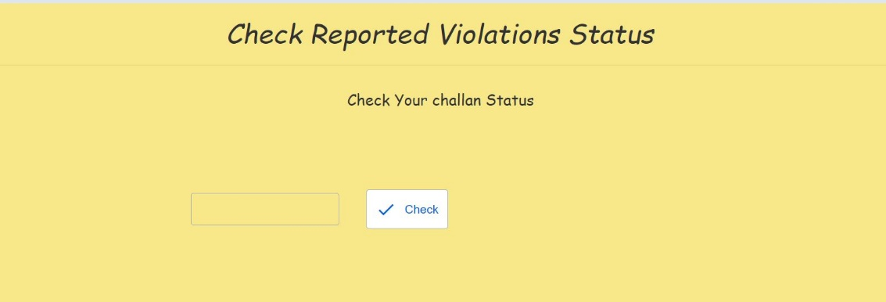
Third Eye – Report & Check Violation Page

Slide 8
Data Service
Third Eye portal Uses Uipath Data Service to Store and Retrieve Data .
This allows easy integration and the ability for the bot to store data without any Third Party Providers
Entities in the Data Service :
Traffic Violation | All the Input Violations are Stored in this entity
Vehicle Database | Master Entity which contains the respective Vehicle and OwnerDetails

Slide 9
Document Understanding
Third Eye Uses Document understanding and Action Centre to Extract information from the vehicle Images and Validate . This ensures that the data doesn’t go into the system without being validated .
The Document Validated Actions are uploaded with the combination of Offence_VehicleNumber .
Properties :
OCR | Microsoft Azure Computer Vision OCR | Used to digitize Text from the Image
Extractor | Regex Based Extractor | To Extract the Vehicle Number from the Digitized Text
Action Centre | Allows to Validate the Image being Submitted against the offence . Helps to Reject / approve / Correct the data being input
* Few of Images for sample
* With the tested Images , Uipath Document Understanding along with Microsoft Computer Vision OCR with Regex Based Extractor provides Confidence more than 90% .

Slide 10
Advantages
A Unified Portal powered with Uipath Robot and Data service and document capabilities makes it more efficient and faster.
Reduce average handling time per report.
Document Understanding and Action Centre Ensures the data that goes into the system is validated .
Data Service Provides the portal with Data modelling and storage options .

Slide 11
Thank you ☺

